Slide 1
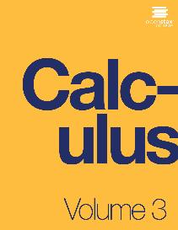

CALCULUS volUME 3
Chapter 5 MULTIPLE INTEGRATION
PowerPoint Image Slideshow

Slide 2

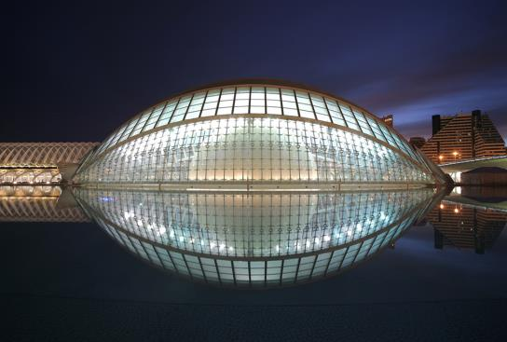
Figure 5.1
The City of Arts and Sciences in Valencia, Spain, has a unique structure along an axis of just two kilometers that was formerly the bed of the River Turia. The l’Hemisfèric has an IMAX cinema with three systems of modern digital projections onto a concave screen of 900 square meters. An oval roof over 100 meters long has been made to look like a huge human eye that comes alive and opens up to the world as the “Eye of Wisdom.” (credit: modification of work by Javier Yaya Tur, Wikimedia Commons)

Slide 3
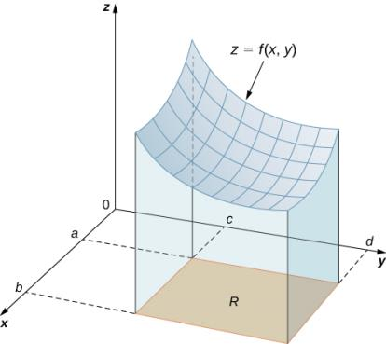
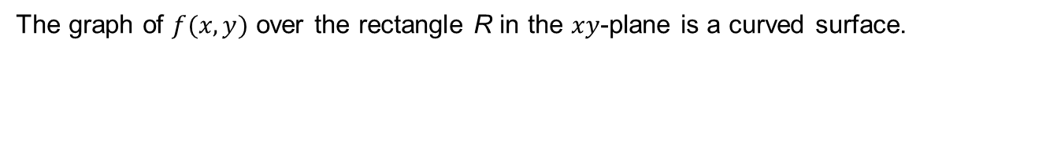
Figure 5.2
The graph of $f(x,y)$ over the rectangle R in the $xy$-plane is a curved surface.

Slide 4
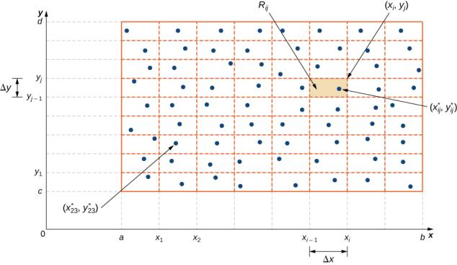
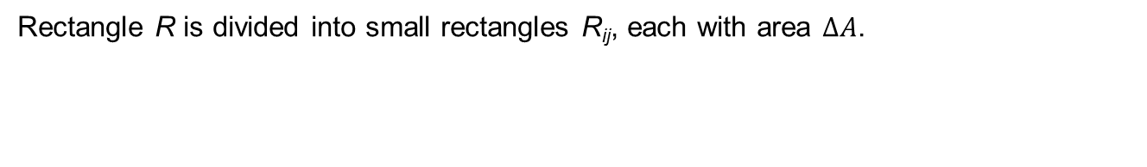
Figure 5.3
Rectangle R is divided into small rectangles R_{ij}, each with area $∆A$.

Slide 5
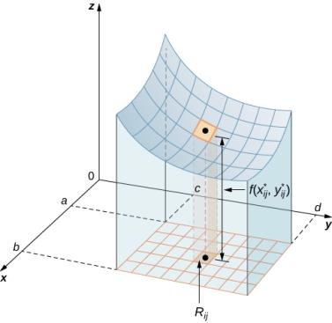
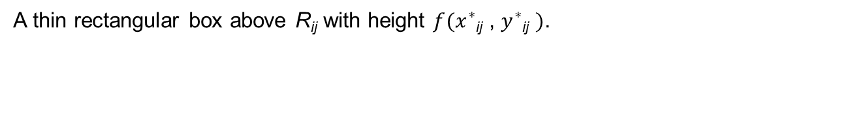
Figure 5.4
A thin rectangular box above R_{ij} with height $f(x^{∗}$_{ij} , $y^{∗}$_{ij} $)$.

Slide 6
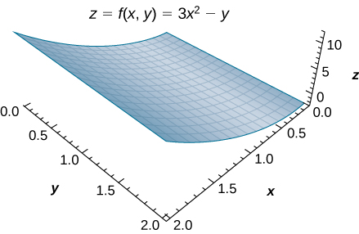
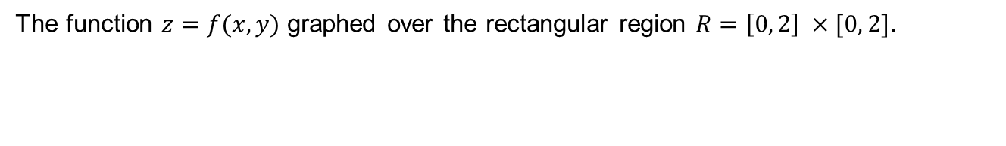
Figure 5.5
The function $z=f(x, y)$ graphed over the rectangular region $R=\left[0, 2\right] ×[0, 2]$.

Slide 7
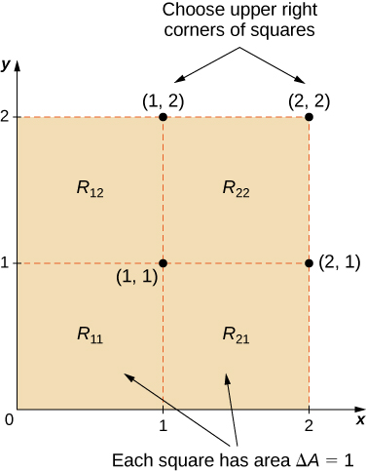
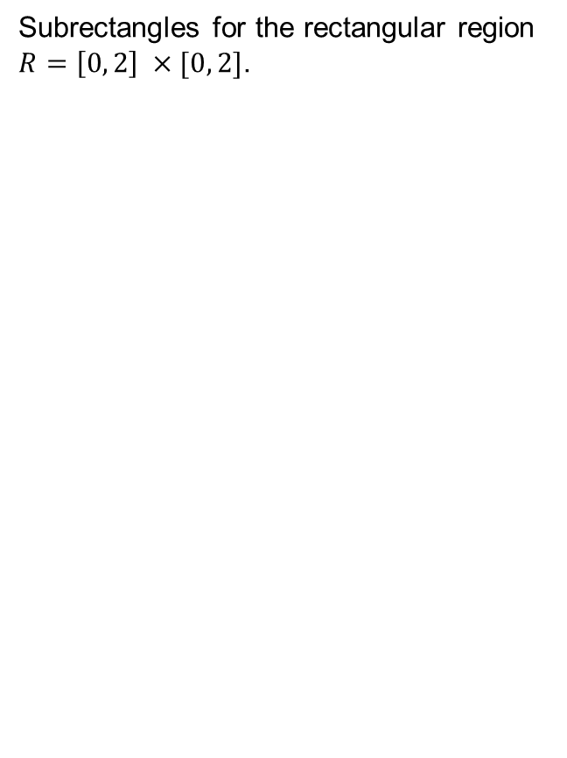
Figure 5.6
Subrectangles for the rectangular region $R=\left[0, 2\right] ×[0, 2]$.

Slide 8
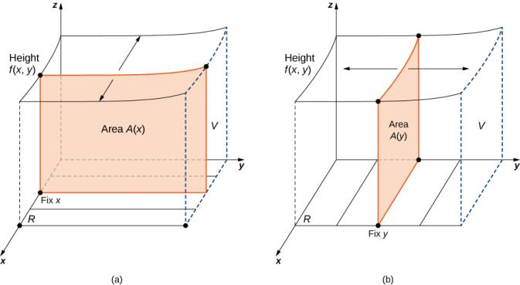
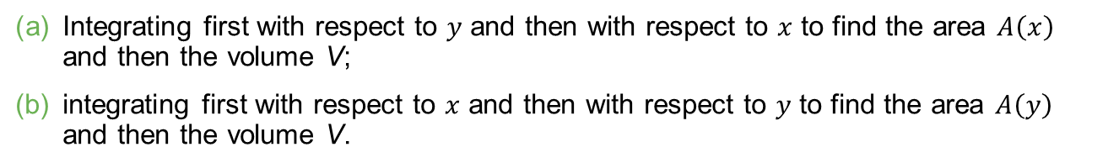
Figure 5.7
Integrating first with respect to $y$ and then with respect to $x$ to find the area $A\left(x\right)$ and then the volume V;
integrating first with respect to $x$ and then with respect to $y$ to find the area $A\left(y\right)$ and then the volume V.

Slide 9
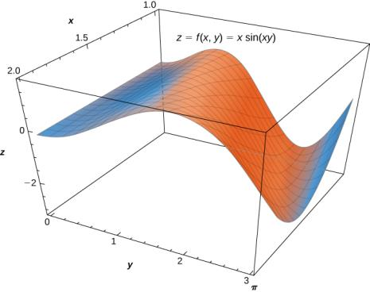
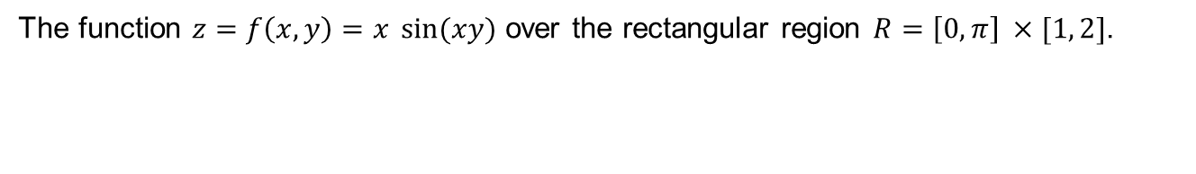
Figure 5.8
The function $z=f\left(x, y\right)=x \sin{(xy)}$ over the rectangular region $R=\left[0, π\right] ×[1, 2]$.

Slide 10
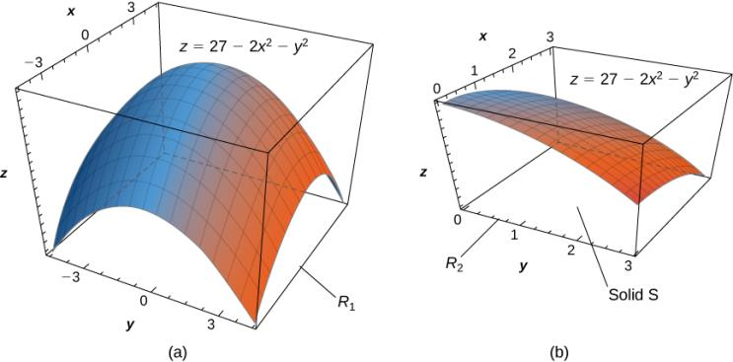
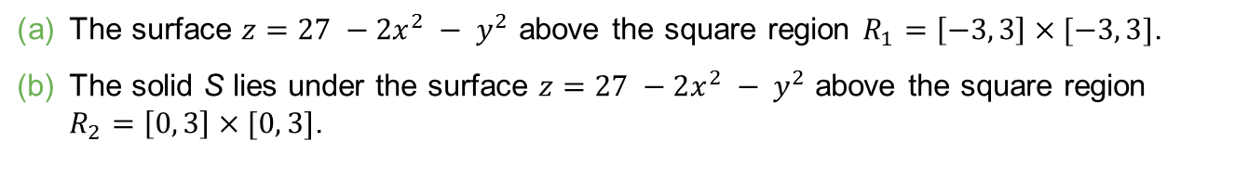
Figure 5.9
The surface $z=27 −2x^{2} − y^{2}$ above the square region $R_{1}=\left[−3, 3\right]×[−3, 3]$.
The solid S lies under the surface $z=27 −2x^{2} − y^{2}$ above the square region $R_{2}=\left[0, 3\right]×[0, 3]$.

Slide 11
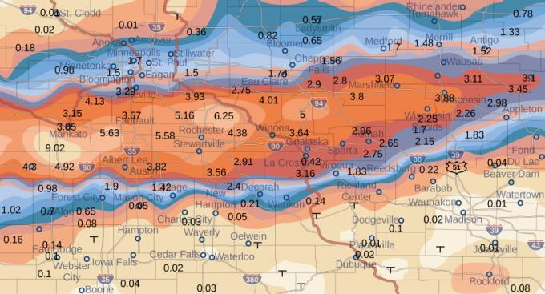
Figure 5.10
Effects of Hurricane Karl, which dumped 4–8 inches (100–200 mm) of rain in some parts of southwest Wisconsin, southern Minnesota, and southeast South Dakota over a span of 300 miles east to west and 250 miles north to south.

Slide 12
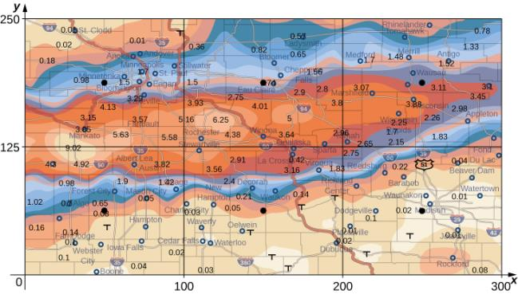
Figure 5.11
Storm rainfall with rectangular axes and showing the midpoints of each subrectangle.

Slide 13
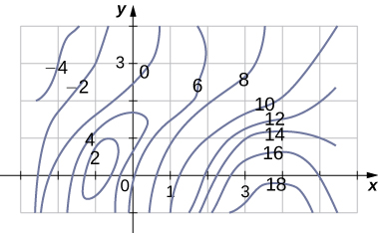

Slide 14
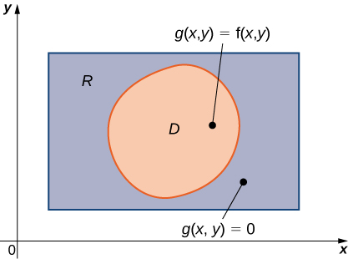
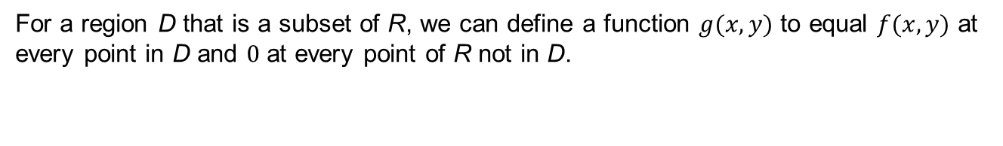
Figure 5.12
For a region D that is a subset of R, we can define a function $g(x, y)$ to equal $f(x, y)$ at every point in D and $0$ at every point of R not in D.

Slide 15
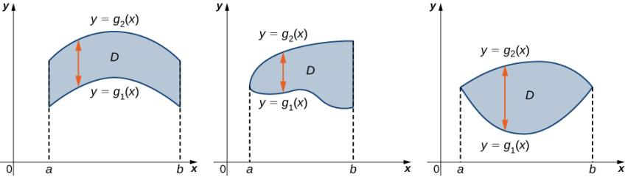
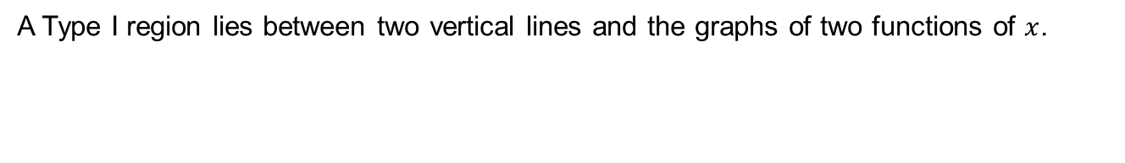
Figure 5.13
A Type I region lies between two vertical lines and the graphs of two functions of $x$.

Slide 16
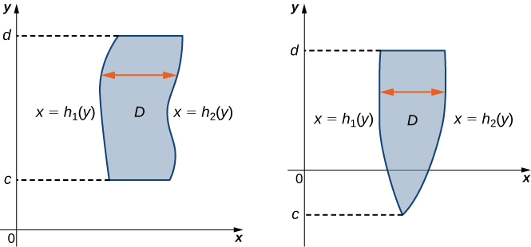
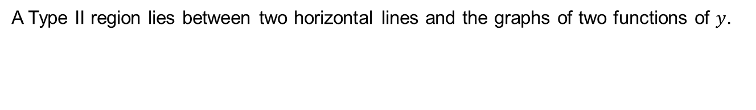
Figure 5.14
A Type II region lies between two horizontal lines and the graphs of two functions of $y$.

Slide 17
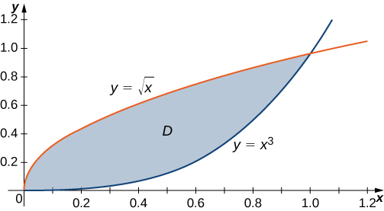
Figure 5.15
Region D can be described as Type I or as Type II.

Slide 18
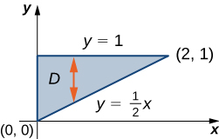
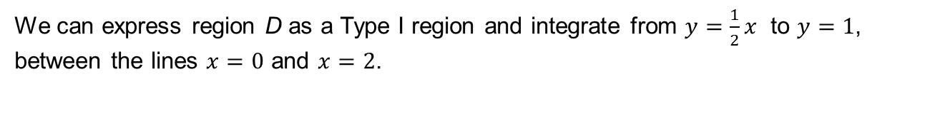
Figure 5.16
We can express region D as a Type I region and integrate from $y=\frac{1}{2}x$ to $y=1$, between the lines $x=0$ and $x=2$.

Slide 19
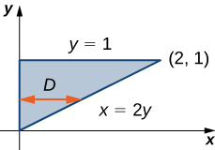
Figure 5.17

Slide 20
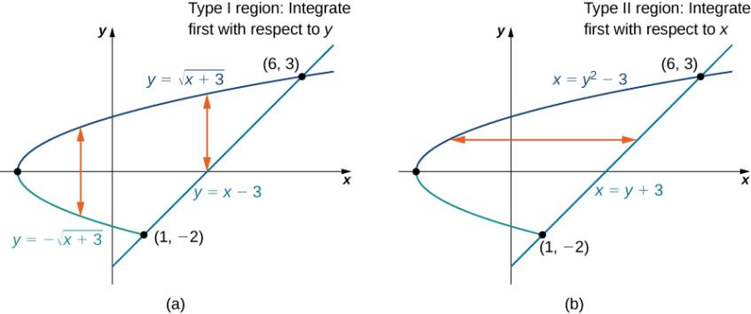
Figure 5.18
The region D in this example can be either (a) Type I or (b) Type II.

Slide 21
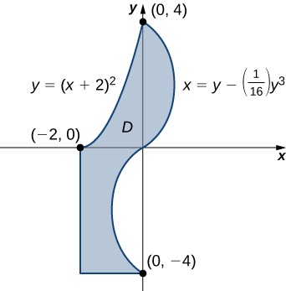
Figure 5.19
This region can be decomposed into a union of three regions of Type I or Type II.

Slide 22
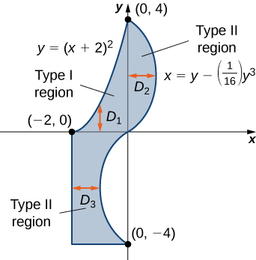
Figure 5.20
Breaking the region into three subregions makes it easier to set up the integration.

Slide 23
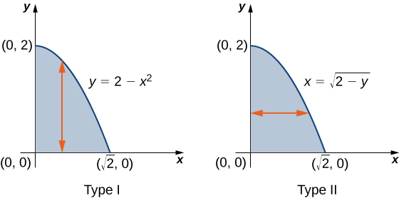
Figure 5.21
Converting a region from Type I to Type II.

Slide 24
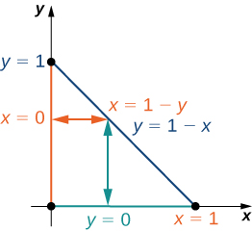
Figure 5.22
A triangular region R for integrating in two ways.

Slide 25
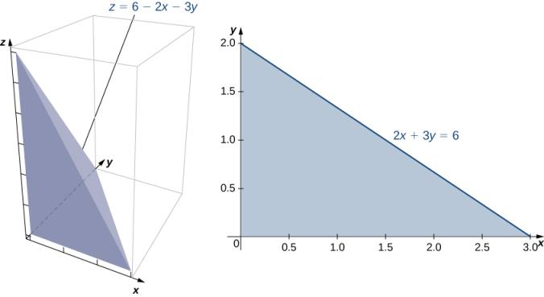
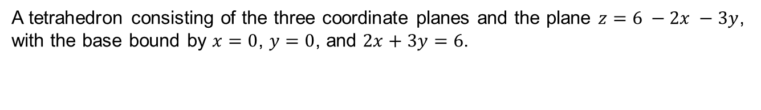
Figure 5.23
A tetrahedron consisting of the three coordinate planes and the plane $z=6 −2x −3y$, with the base bound by $x=0$, $y=0$, and $2x+3y=6$.

Slide 26
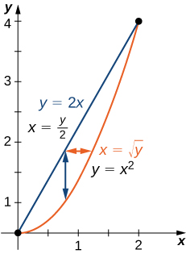
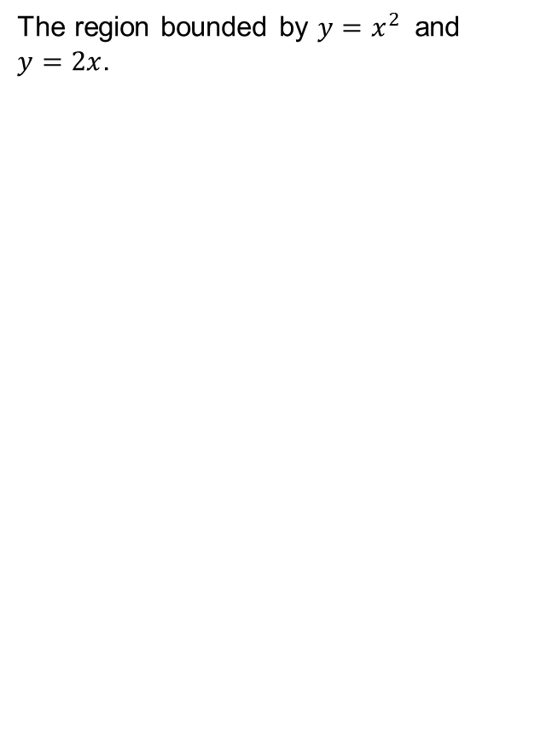
Figure 5.24
The region bounded by $y=x^{2}$ and $y=2x$.

Slide 27
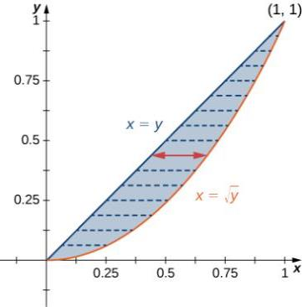
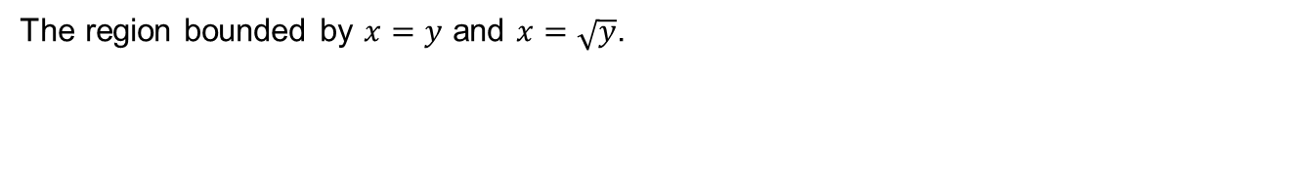
Figure 5.25
The region bounded by $x=y$ and $x=\sqrt{y}$.

Slide 28
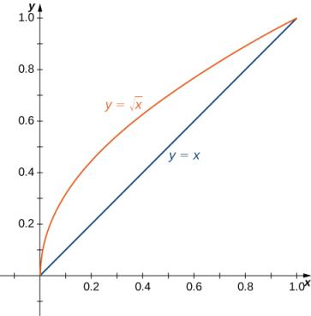
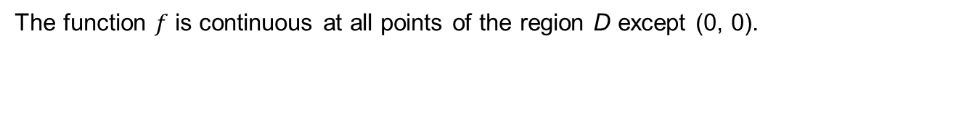
Figure 5.26
The function $f$ is continuous at all points of the region D except (0, 0).

Slide 29
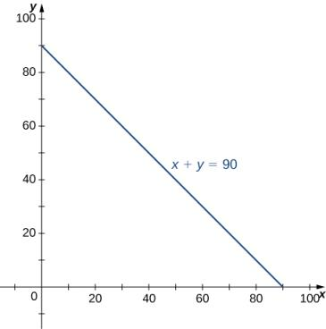
Figure 5.27
The region of integration for a joint probability density function.

Slide 30
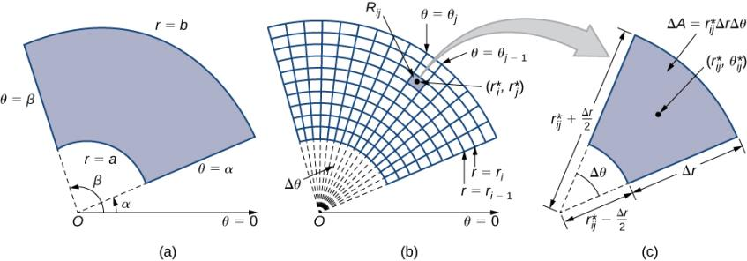
Figure 5.28
A polar rectangle R
divided into subrectangles R_{ij}.
Close-up of a subrectangle.

Slide 31
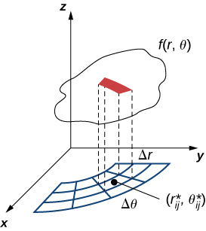
Figure 5.29
Finding the volume of the thin box above polar rectangle R_{ij}.

Slide 32
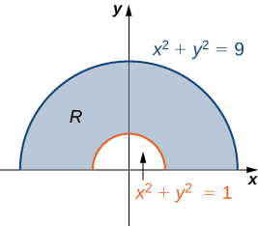
Figure 5.30
The polar region R lies between two semicircles.

Slide 33
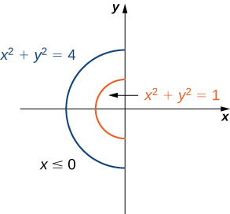
Figure 5.31
The annular region of integration R.

Slide 34
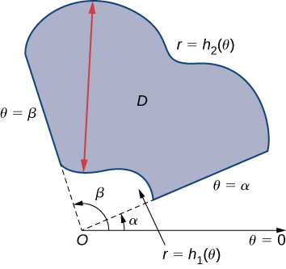

Figure 5.32
A general polar region between $α< θ< β$ and $h_{1}\left(θ\right)<r< h_{2}(θ)$.

Slide 35

Figure 5.33
The region D is the top half of a cardioid.

Slide 36

Figure 5.34
Finding the volume of a solid under a paraboloid and above the unit circle.

Slide 37

Figure 5.35
Finding the volume of a solid with a paraboloid cap and a circular base.

Slide 38

Figure 5.36
Finding the volume of a solid under a paraboloid and above a given triangle.

Slide 39


Figure 5.37
Finding the volume of a solid inside the cone and above the $xy$–plane.

Slide 40

Figure 5.38
Finding the area of a polar rose with eight petals.

Slide 41

Figure 5.39
Finding the area enclosed by both a circle and a cardioid.

Slide 42

Figure 5.40
A rectangular box in ℝ ³ divided into subboxes by planes parallel to the coordinate planes.

Slide 43

Figure 5.41
Evaluating a triple integral over a given rectangular box.

Slide 44


Figure 5.42
We can describe region E as the space between $u_{1}(x, y)$ and $u_{2}(x, y)$ above the projection D of E onto the $xy$-plane.

Slide 45


Figure 5.43
A box E where the projection D in the $xy$-plane is of Type I.

Slide 46


Figure 5.44
A box E where the projection D in the $xy$-plane is of Type II.

Slide 47


Figure 5.45
The solid E has a projection D on the $xy$-plane of Type I.

Slide 48

Figure 5.46
Finding the volume of a pyramid with a square base.

Slide 49

Figure 5.47
The three cross sections of E on the three coordinate planes.

Slide 50

Figure 5.48
Integrating a triple integral over a paraboloid.

Slide 51


Figure 5.49
Cross section in the $xy$-plane of the paraboloid in Figure 5.48.

Slide 52


Figure 5.50
Cylindrical coordinates are similar to polar coordinates with a vertical $z$ coordinate added.

Slide 53

Figure 5.51
A cylindrical box B described by cylindrical coordinates.

Slide 54

Figure 5.52
Setting up a triple integral in cylindrical coordinates over a cylindrical region.

Slide 55

Figure 5.53
Setting up a triple integral in cylindrical coordinates over a conical region.

Slide 56

Figure 5.54
Finding a cylindrical volume with a triple integral in cylindrical coordinates.

Slide 57

Figure 5.55
The spherical coordinate system locates points with two angles and a distance from the origin.

Slide 58

Figure 5.56
Spherical coordinates are especially convenient for working with solids bounded by these types of surfaces. (The letter c indicates a constant.)

Slide 59

Figure 5.57
The volume element of a box in spherical coordinates.

Slide 60

Figure 5.58
A region bounded below by a cone and above by a hemisphere.

Slide 61

Figure 5.59
A region bounded below by a cone and above by a sphere.

Slide 62


Slide 63

Figure 5.60
(credit: modification of work by Javier Yaya Tur, Wikimedia Commons)

Slide 64

Figure 5.61
Balloons lift off at the 2001 Albuquerque International Balloon Fiesta. (credit: David Herrera, Flickr)

Slide 65

Figure 5.62
Use a half sphere to model the top part of the balloon and a frustum of a cone to model the bottom part of the balloon.
A cross section of the balloon showing its dimensions.

Slide 66

Figure 5.63
Activating the burner heats the air in a 20-foot-high, 12-foot-wide column directly above the burner.

Slide 67

Figure 5.64
A lamina is perfectly balanced on a spindle if the lamina’s center of mass sits on the spindle.

Slide 68

Figure 5.65
The density of a lamina at a point is the limit of its mass per area in a small rectangle about the point as the area goes to zero.

Slide 69


Figure 5.66
Subdividing the lamina into tiny rectangles R_{ij}, each containing a sample point ($x^{∗}$_{ij}, $y^{∗}$_{ij}).

Slide 70


Figure 5.67
A lamina in the $xy$-plane with density $ρ\left(x, y\right)=xy$.

Slide 71


Figure 5.68
Locating the center of mass of a lamina R with density $ρ\left(x, y\right)=x+ y$.

Slide 72


Figure 5.69
Finding a centroid of a region below the curve $y= e^{x}$.

Slide 73


Figure 5.70
Finding the mass of a three-dimensional solid $Q$.

Slide 74


Figure 5.71
The transformation of a region G in the $uv$-plane into a region R in the $xy$-plane.

Slide 75


Figure 5.72
A rectangle in the $rθ$-plane is mapped into a quarter circle in the $xy$-plane.

Slide 76


Figure 5.73
A triangular region in the $uv$-plane is transformed into an image in the $xy$-plane.

Slide 77


Figure 5.74
A small rectangle S in the $uv$-plane is transformed into a region R in the $xy$-plane.

Slide 78


Figure 5.75
The subrectangles S_{ij} in the $uv$-plane transform into subrectangles R_{ij} in the $xy$-plane.

Slide 79

Figure 5.76
Changing a region from rectangular to polar coordinates.

Slide 80

Figure 5.77
The region of integration for the given integral.

Slide 81


Figure 5.78
A parallelogram in the $xy$-plane that we want to transform by a change in variables.

Slide 82

Figure 5.79
Transforming the region R into the region S to simplify the computation of an integral.

Slide 83


Figure 5.80
A region G in $uvw$-space mapped to a region D in $xyz$-space.

Slide 84


Figure 5.81
The transformation from rectangular coordinates to cylindrical coordinates can be treated as a change of variables from region G in $rθz$-space to region D in $xyz$-space.

Slide 85


Figure 5.82
The transformation from rectangular coordinates to spherical coordinates can be treated as a change of variables from region G in $ρθφ$-space to region D in $xyz$-space.

Slide 86


Figure 5.83
The region G in $uvw$-space is transformed to region D in $xyz$-space.

Slide 87
This OpenStax ancillary resource is © Rice University under a CC BY-NC-SA 4.0 International license; it may be reproduced or modified for noncommercial purposes only but must be attributed to OpenStax, Rice University and any changes must be noted. Any adaptation must be shared under the same type of license.

